Slide 1
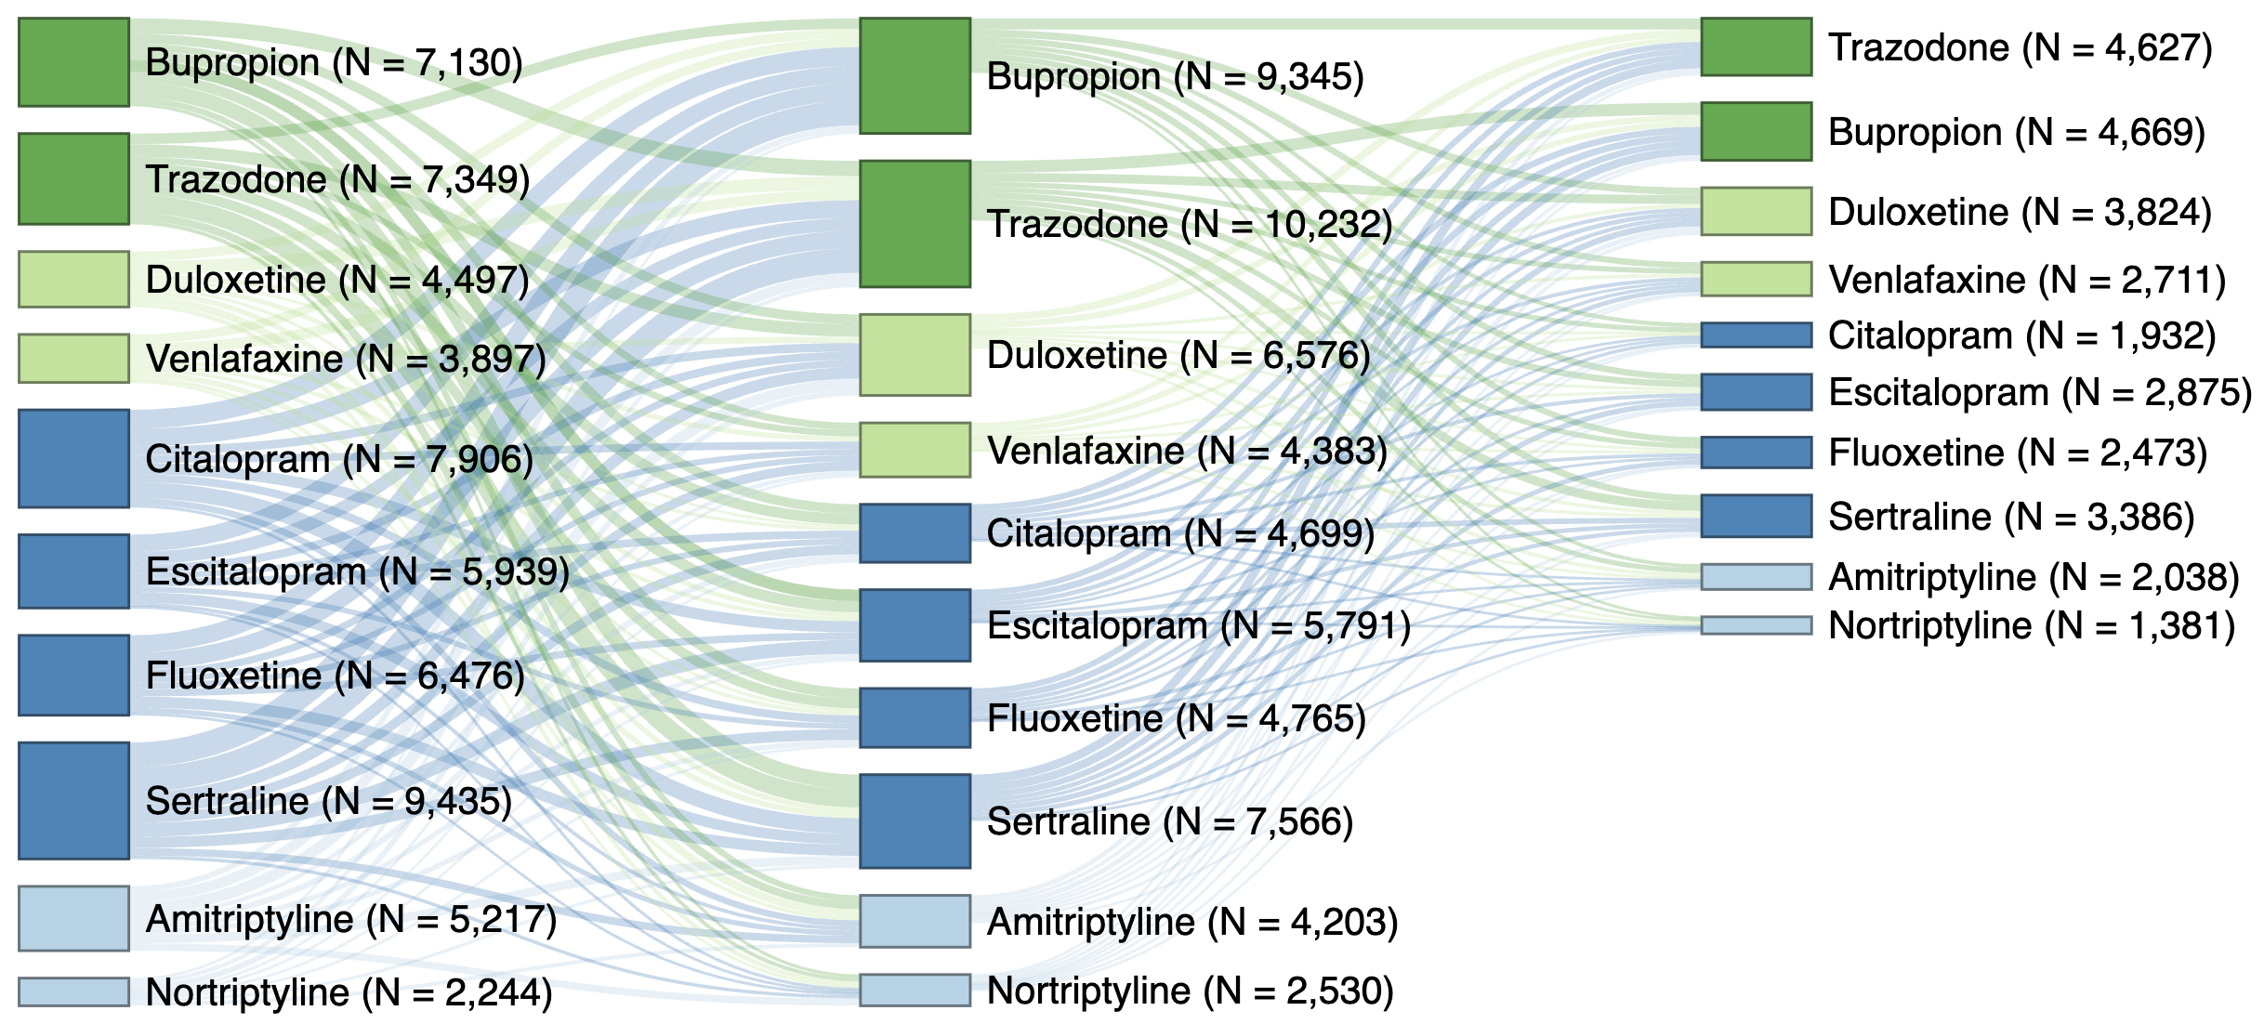
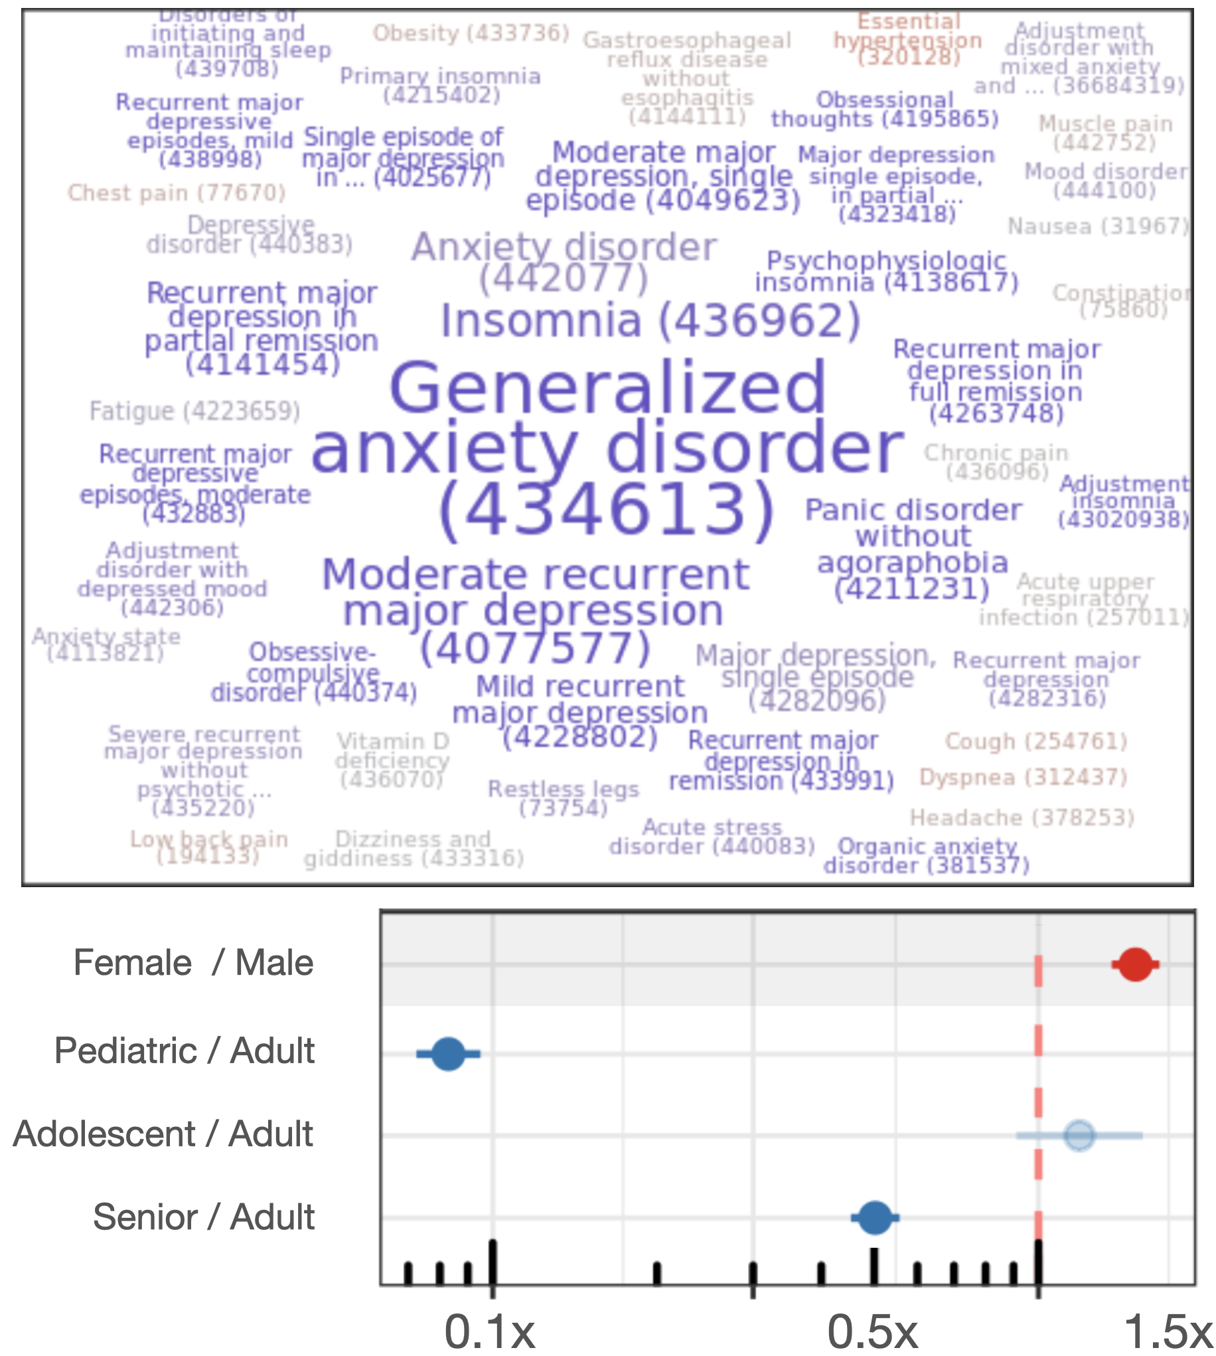
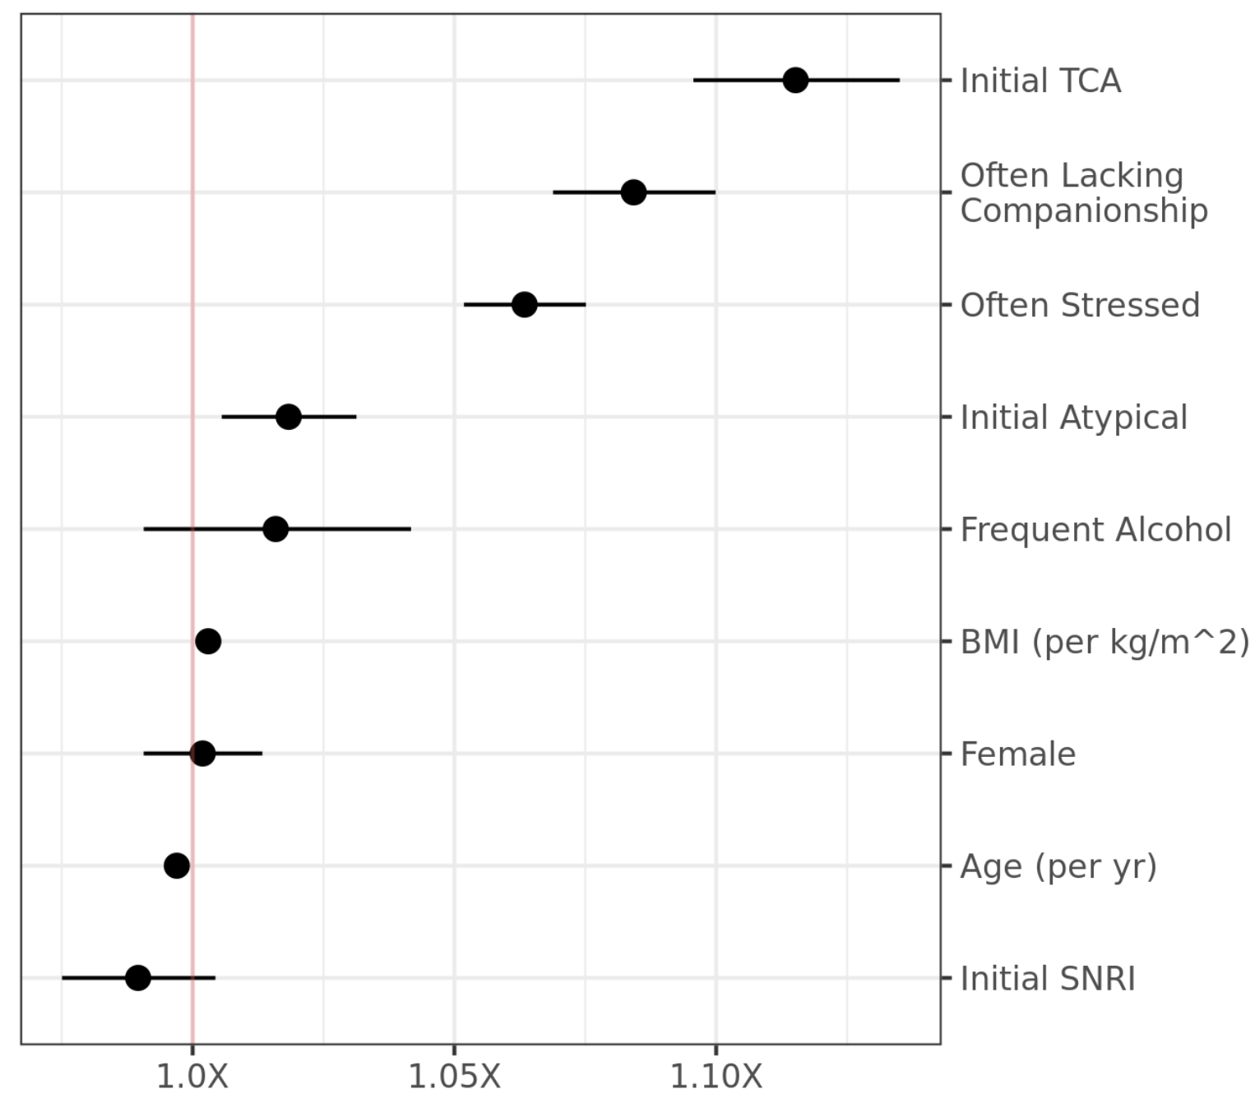
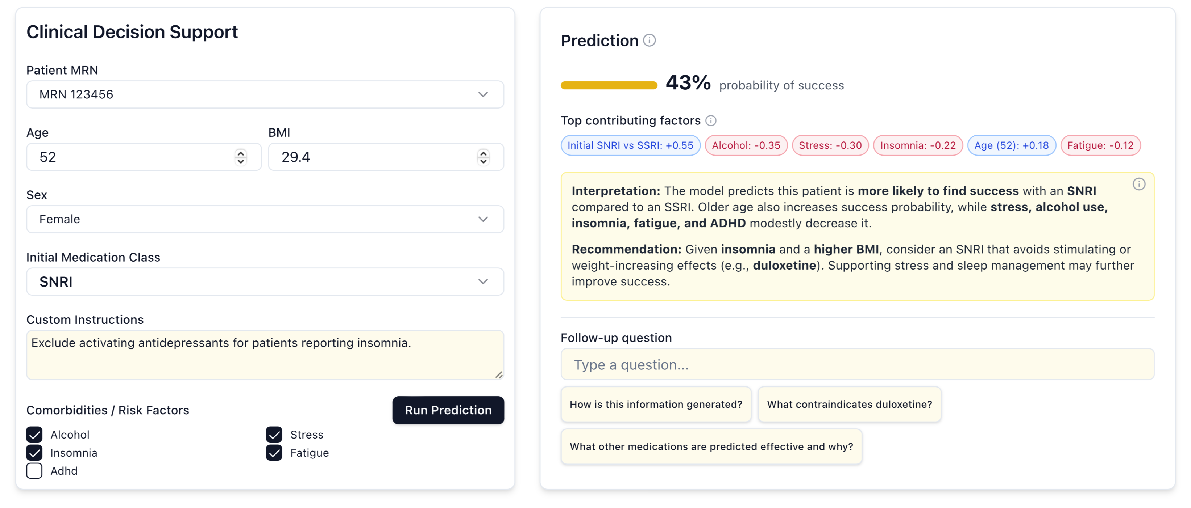
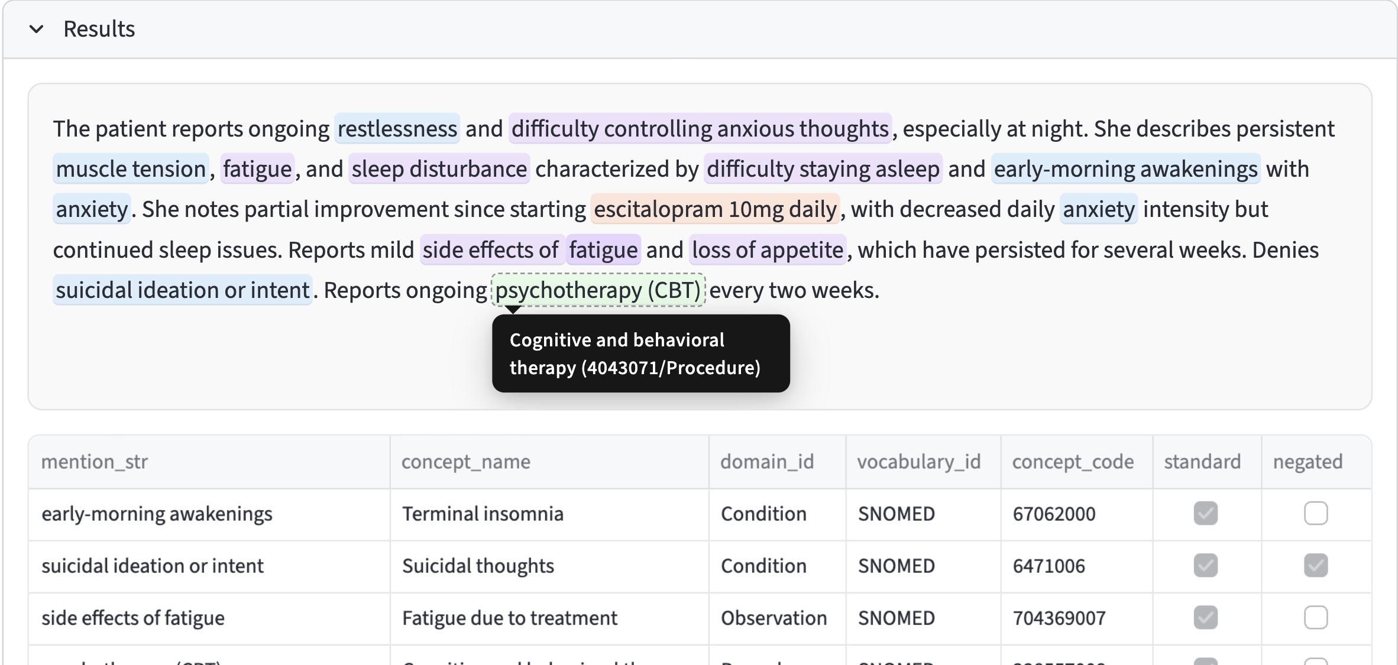



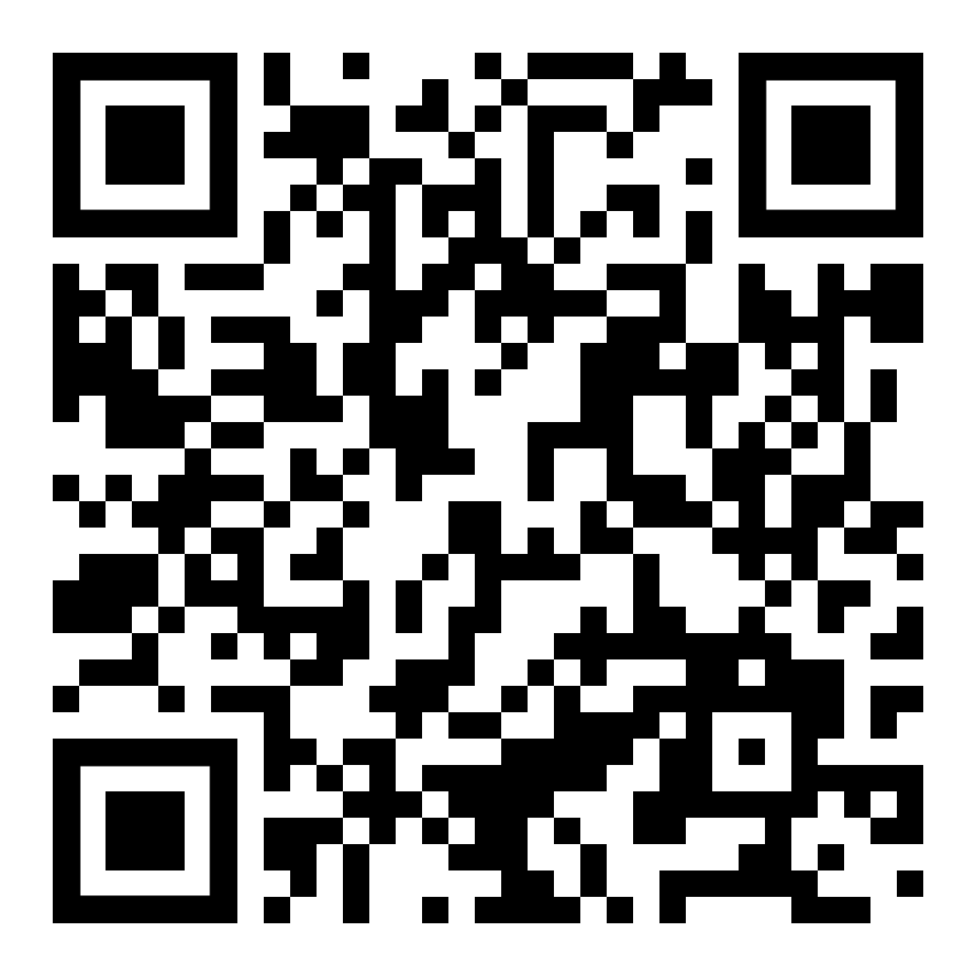

Data-driven Prescribing for Anxiety & Depression
Better, faster care with with generative AI & interpretable ML
Extract, Predict, Support: Improving Medication Choice and Outcomes from Clinical Data to Decision Support
The Need: Alongside psychotherapy, medication is widely used to treat Anxiety and Depression, with hundreds of millions of prescriptions written each year. However, no individual medication is universally effective, and limited information is available to guide treatment choice. This is a significant issue: upwards of 45% of patients switch medications due to ineffectiveness or adverse side effects, including weight changes, sexual dysfunction, fatigue, headaches, and suicidal ideation.
The goal: We aim to help patients find the right medication faster and with less trial-and-error. Using large-scale Electronic Health Record (EHR) data, we are developing privacy-preserving, explainable machine learning (ML) models to predict medication effectiveness for individual patients. To assist prescribers in interpreting and using this information, we are integrating these models alongside established care guidelines in generative-AI interfaces, providing on-demand decision support respecting clinician expertise and supporting patient engagement for improved, personalized care.
Over 45% of patients switch or augment to find effective treatment.
Large-scale EHR data uncovers patterns and predicts outcomes.
Class
Atypical
SNRI
SSRI
Tricyclic
1+ modification: 60,090 (48.8%)
2+ modifications: 29,916 (24.3%)
Cluster Association
Odds of Modifying (vs. Male w/ Initial SSRI)
Across 123,010 patients with an initial diagnosis of anxiety and/or depression treated with medication, 48% switch to (or later augment with) another medication, 24% more than once. Top ten medications and up to two modifications shown; see QR code for methods, limitations, and data sources.
Unsupervised clustering reveals patterns in comorbidities and patient features (left); female patients are strongly associated with this cluster, one of many across 8M+ patients. Switching/augmenting can be predicted (right); stress, companionship, and medication class influence baseline modification rates.
Generative AI Can Help!
Generative AI turns explainable ML into interpretable ML.
Important ‘dark data’ is buried in sensitive clinical notes.
Clinicians make rapid decisions in information-rich environments. Explainable machine learning promises an era of personalized medicine, but these complex methods require time and specialized knowledge to use effectively. Generative AI-enhanced interfaces can serve as interpreters for effective decision making backed by models, data, and guidelines; co-designed interfaces facilitate shared decision making and patient engagement. Example interface and mock data shown.
Structured EHR data enables predictive modeling, but misses information found only in privacy-sensitive free-text notes. We are developing LLM-based pipelines to ‘code’ outcomes and risk factors, quantifying how patients experience these conditions and treatments, improving models, and enhancing privacy in research. Our agent-based pipeline navigates medical vocabularies inspired by human annotation processes, including re-phrasing and hierarchical medical concept searching. Mock note data shown.
Patient Voices, Clinician Expertise
In addition to core team members’ significant experiences and patient advocacy, we are incorporating both lived experience and clinician knowledge via a Community Advisory Board (CAB). Early ‘journey mapping’ exercises with both groups reveal a diversity of considerations for decision-making, and we will incorporate CAB input at multiple stages, including modeling choices and validation, interface design and testing, and publication and dissemination. The CAB will supplement a Steering Committee providing ethical oversight, considering issues in data safety, bias, stigmatization, and benefit distribution.
Journey mapping reveals decision points and influences.
Alternative treatments
Stop medication
Increase dose
First meeting
Medication selection
Follow-up
Decrease dose
Patient information
Provider information
Side effects
Patient concerns
Symptom change
Side effects
Change or augment medication
Shawn T. O’Neil, PhD,¹ Eric Hurwitz, PhD,¹ Rachel Presskreicher, PhD,^{1,2} Chris Roeder, MS,¹ Divya Varun,¹ Sruthi Magesh,¹ Shilpa Sundar, PharmD,¹ Said Alhassan,^{3,4} Danielle Lowe, PhD, MD,² Melissa A. Haendel, PhD, FACMI.¹ University of North Carolina Chapel Hill Dept. of Genetics,¹ UNC Dept. of Psychiatry,² National Alliance for Mental Health (NAMI) Orange County, ³ UNC Dept. of Neurology ⁴

